Slide 1
Wine Quality Analysis
By Kaustubha ram p

Slide 2
Main KPIs
Alcohol pH
Average Quality
Sulphates, chlorides quantity

Slide 3
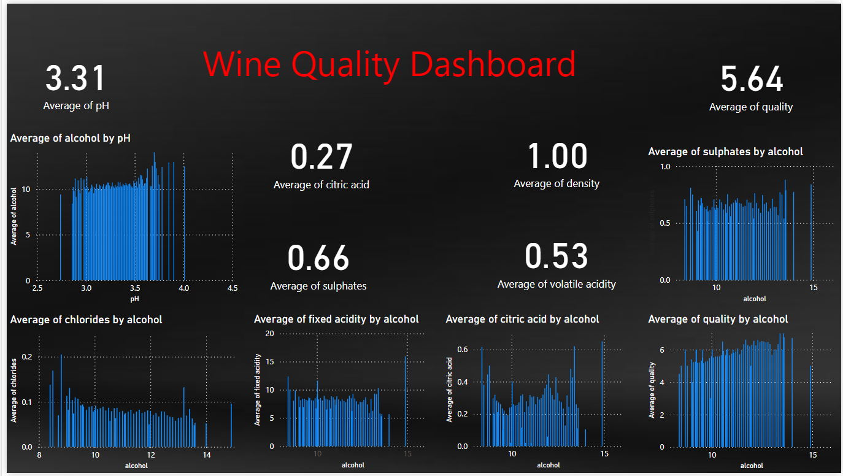
Dashboard

Slide 4
Key Insights
Average pH is 3.31
Average quality is 5.64
Average density is 1
More sulphates leads to more acidity

Slide 5
Thank You

